Slide 1

E-Post Office System
DEPARTMENT OF INFORMATION TECHNOLOGY
Submitted to: Submitted by:
Mrs. Neha Janu Aanchal Mittal(12eskit001) Anamika Gupta(12eskit014)
Guided by: Ayushi Jain(12eskit023) Mr. Mukesh Gupta Bharti Aggarwal(12eskit025)

Slide 2
Tools and Technology
For Front End
-HTML
-CSS
-JSP
For Back End
-MySQL Database
-Java

Slide 3
CONTENTS
Introduction
What is E-Post ?
Vision of E-Post
Objective
System Analysis
Users of the system
Modules
Conclusion
References

Slide 4
Introduction
The Department of Posts comes under the Ministry of Communications and Information Technology.
For providing postal services, the whole country has been divided into twenty two postal circles.
Each Circle is further divided into Regions comprising field units , called Divisions (Postal / RMS Divisions).

Slide 5
What is E-Post ?
The e-Post is the shopping portal of the world-renowned postal service.
Under this website many stamps and services can be ordered.
It sells stamps , postcards , envelopes etc.

Slide 6
Vision of E-Post
The vision of E-Post is to provide a facility on those rural areas which faces problem of “slow and unreliable” postal service.
At first we are only focusing on selling of stamps and other products.

Slide 7
Objective
The main objective of E-Post system is to provide following services-
Ordering of stamps and other products.
Trace and Track the Post you send.
Reliable Post Service.

Slide 8
System Analysis
Postal System Vs. Online System
Most of the work done here are automated.
Reliable and fast with the help of internet.
Transportation & manual work is reduced and Time is saved.
All the works carried out will be manual.
Not reliable, fast.
More manual work on both client and postal side.

Slide 9
Users of the system
1.Admin – Supreme authority which has all the powers to handle the services. Admin can add/delete products and has control over system flow.
2.Users –there are two type of users.
i . Registered user
ii . Normal user

Slide 10
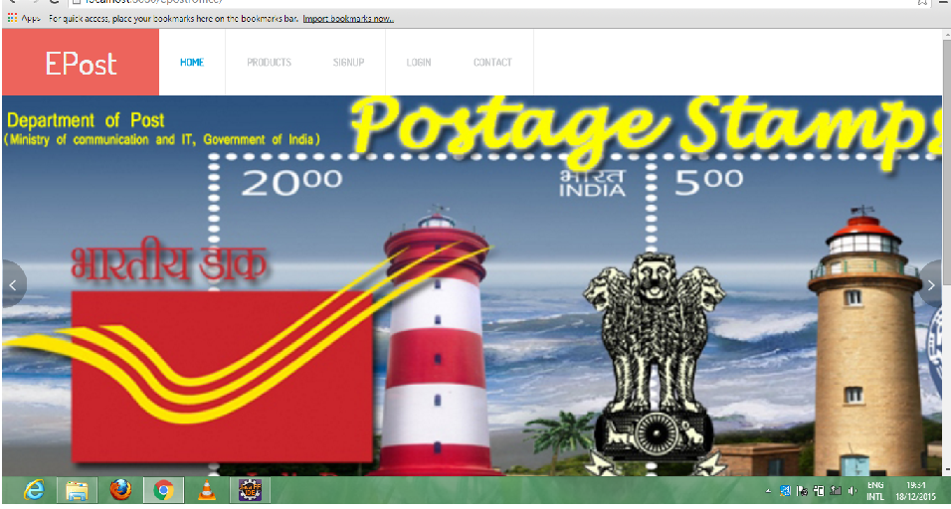
Modules
User module-
i. Front page-this is the front end of E-Post office system.

Slide 11
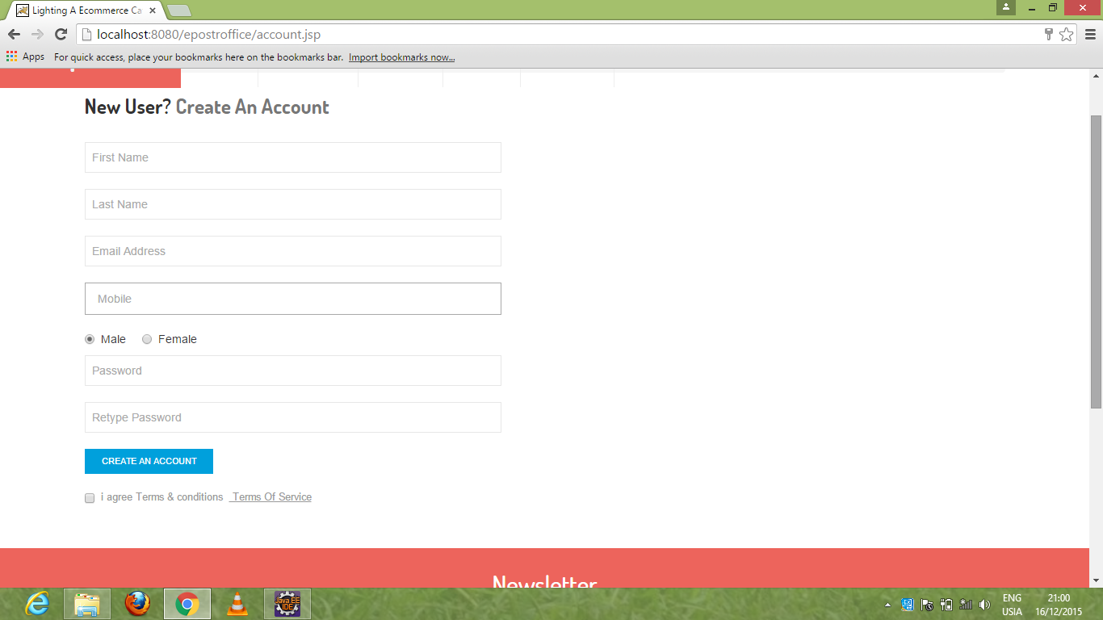
ii.Registration Page-
In this, customer can register through this page by filling the entries. The field are first name , last name, email address, mobile , password.

Slide 12
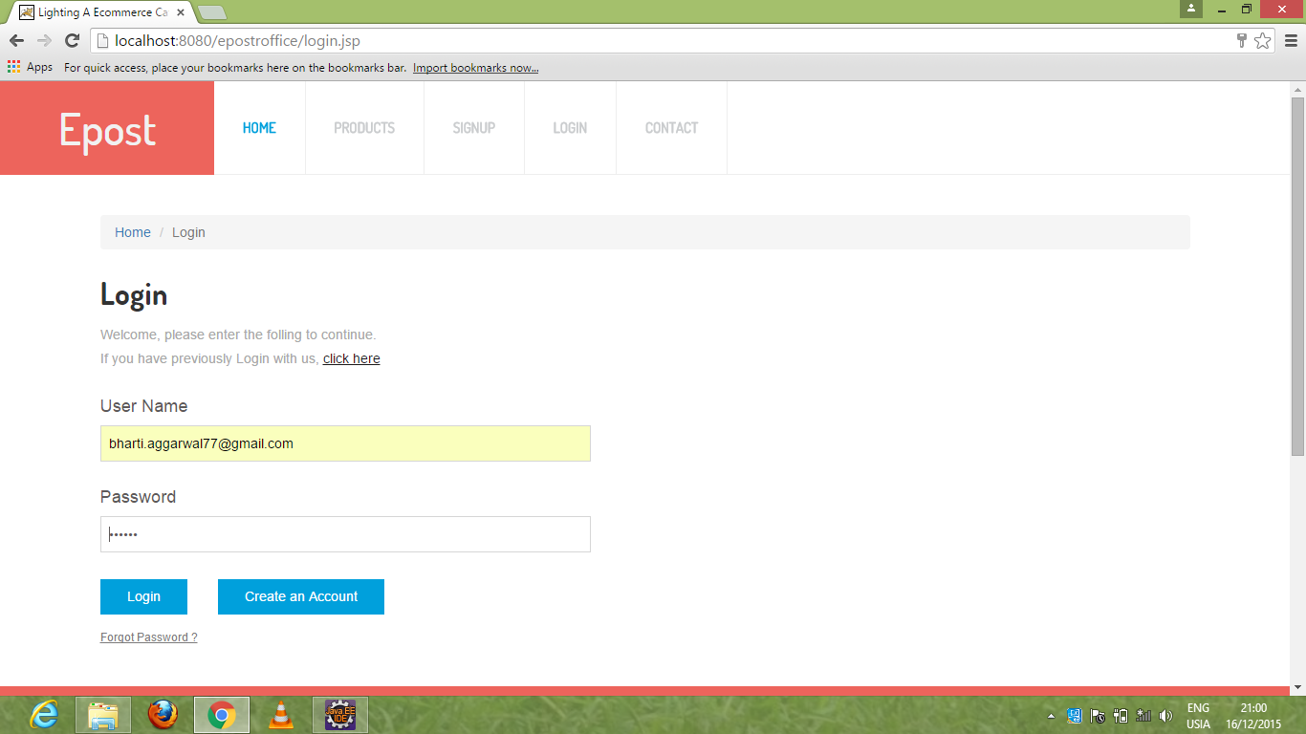
iii.Login Page-
User can login by entering email address, password.

Slide 13
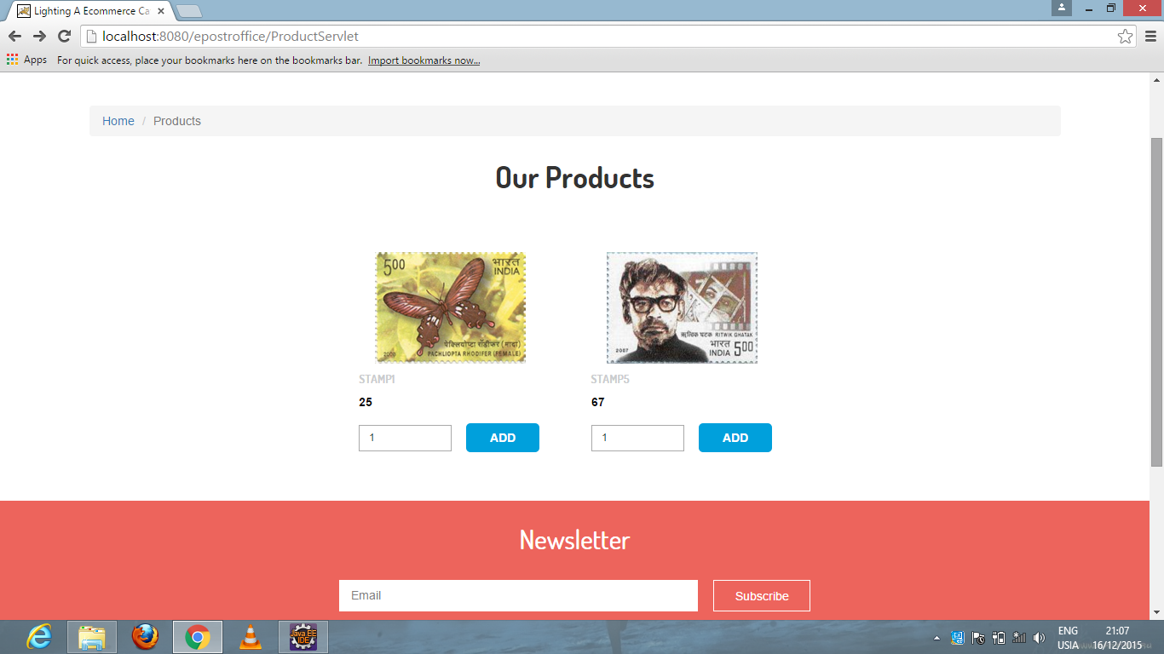
iv. Products-
It contain the images and detail of product which shown to user.

Slide 14
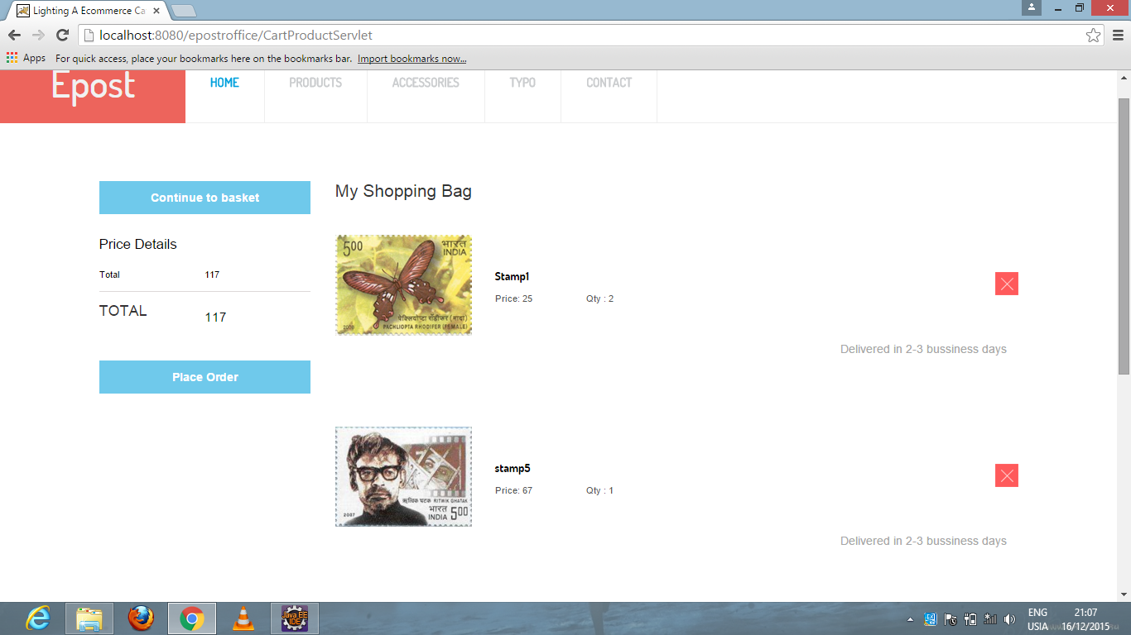
v. Cart-
This will show the product added in the cart by user.

Slide 15
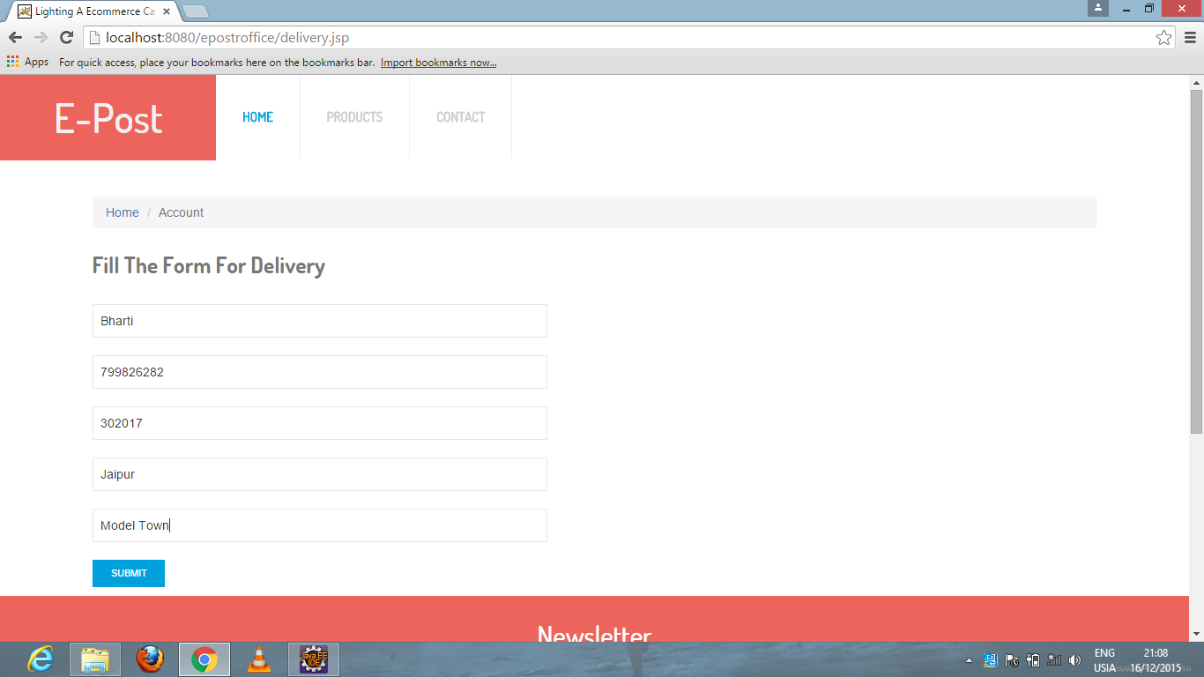
vi. Delivery Details-
While delivering , user has to fill this fields.

Slide 16
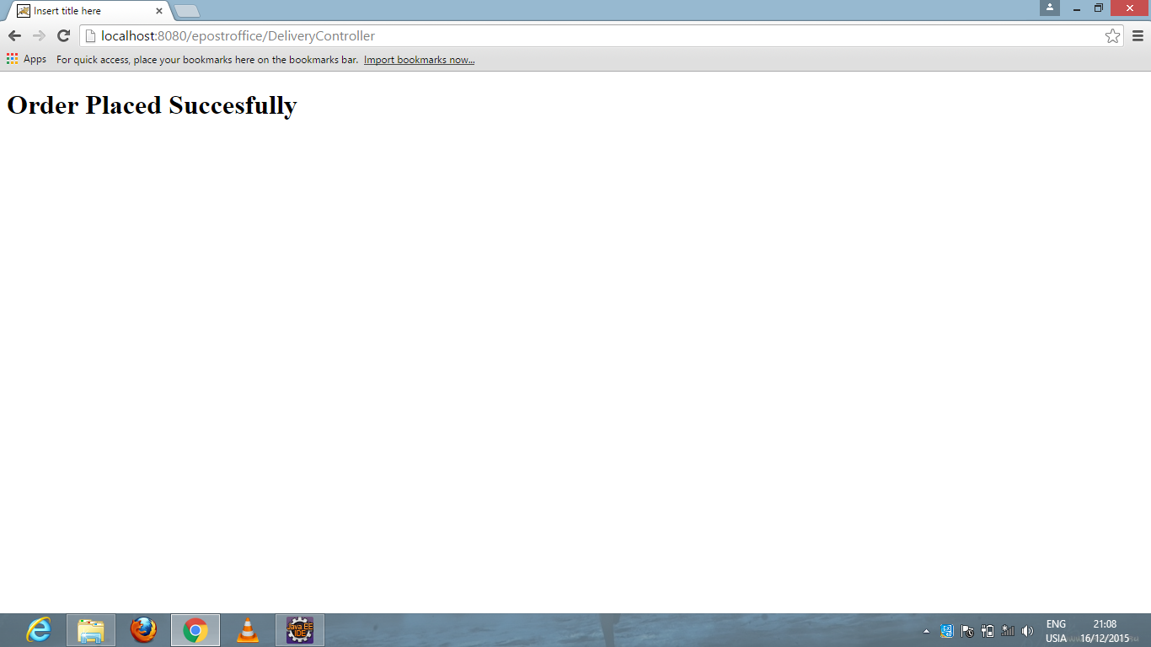
vii. After Submit:
After Submitting, this message will be displayed.

Slide 17
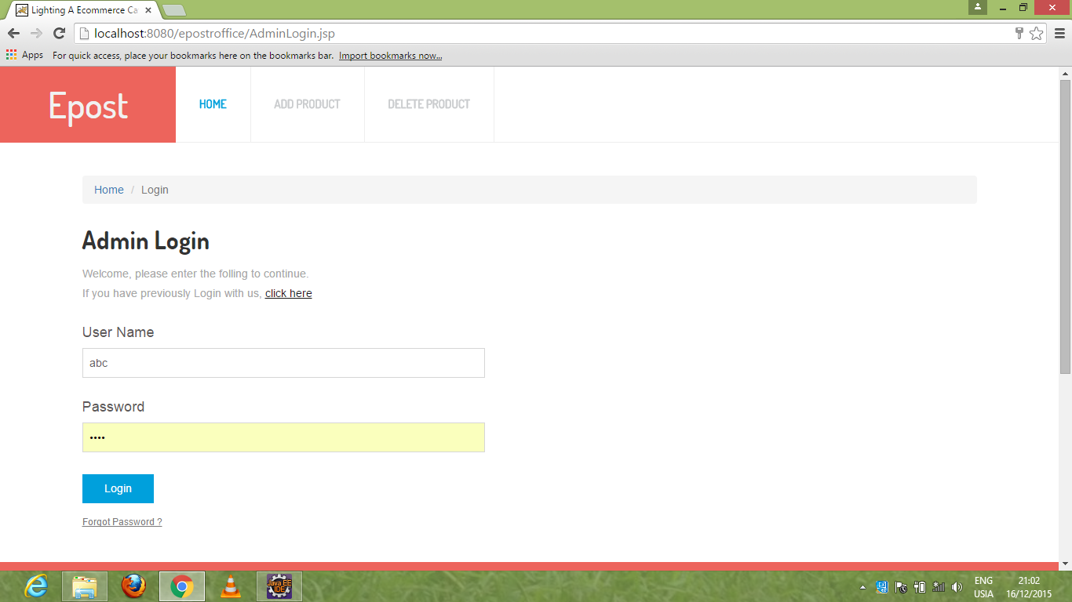
2.Admin Module:
i. Login Page : Admin enter username and password for login.

Slide 18
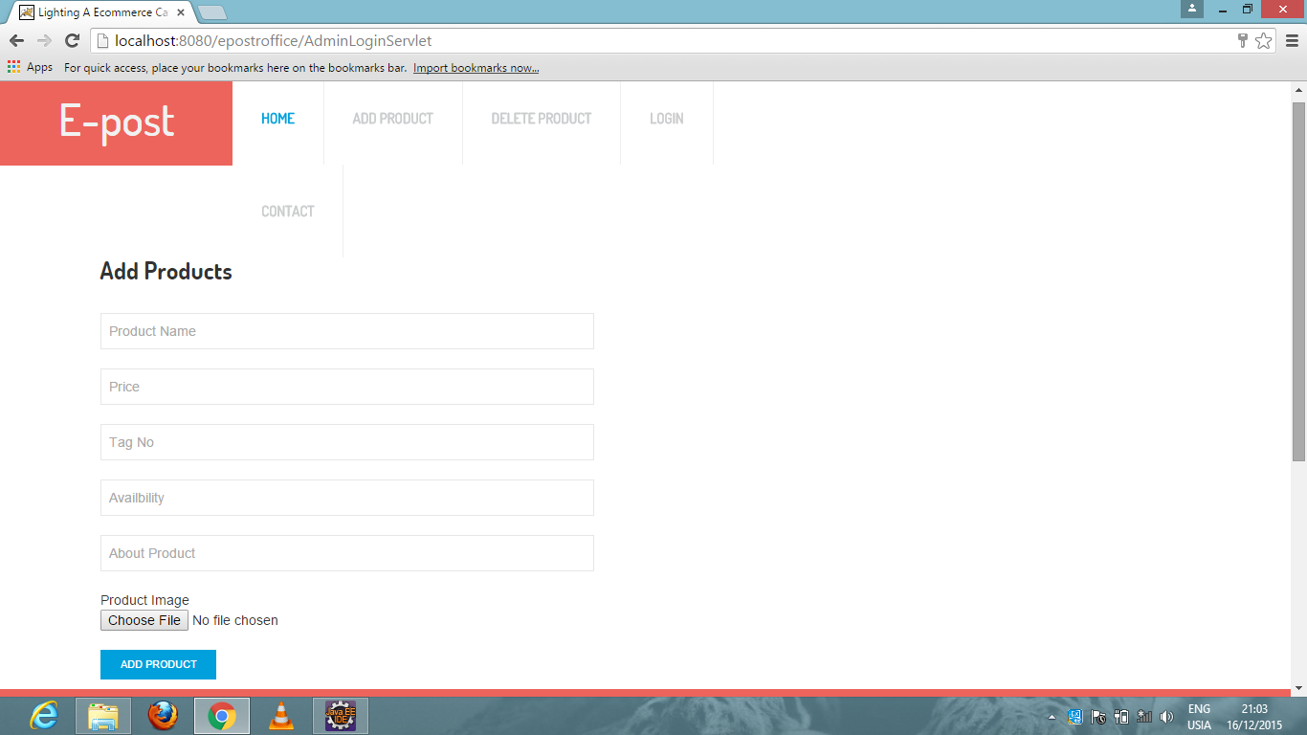
ii.Add Product Page:
Admin has to fill fields like product name, price, tag number, choose file.

Slide 19
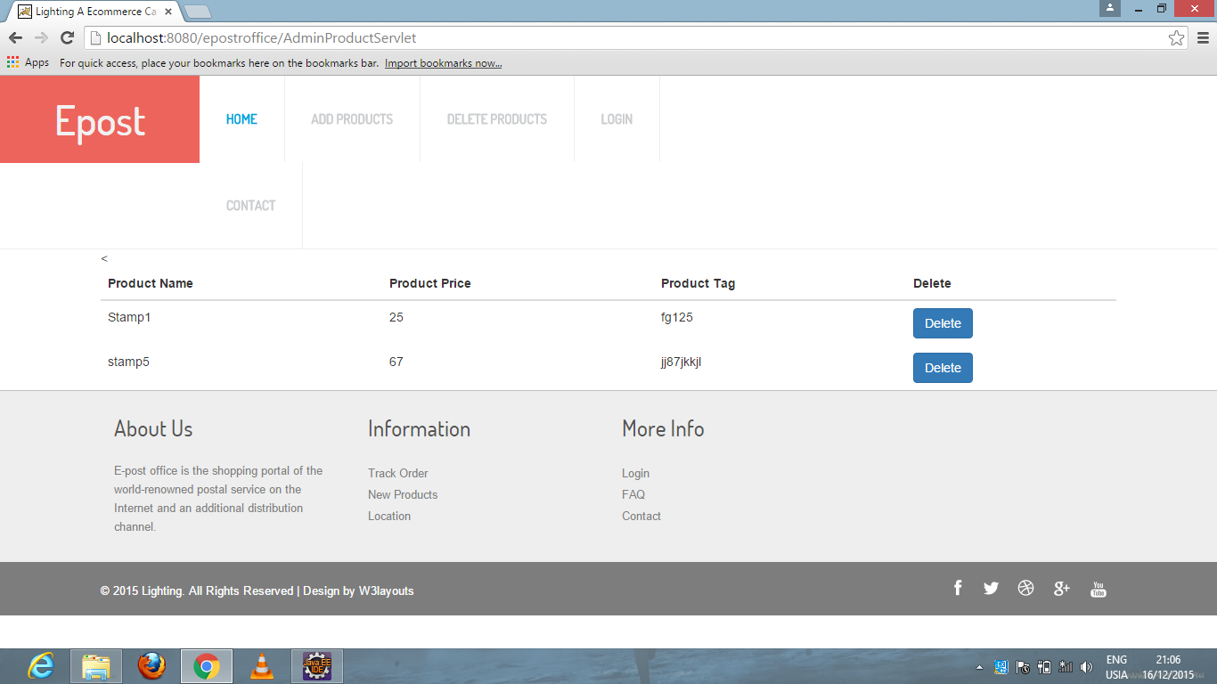
iii. Delete Product Page:
For deleting the product by click on delete button.

Slide 20
iv. Product Page:
Product will be displayed.

Slide 21
Conclusion
This project proved good for us as it provided practical knowledge of programming . This will provide better opportunities and guidance in future in developing projects independently.
BENEFITS:
It’s a web-enabled project.
User friendly.
Data storage and retrieval is faster.
Simpler and client-centric.

Slide 22
Thank you

